Slide 1
Ecommerce Gaming Accessories Design
UX/UI Design JR

Slide 2
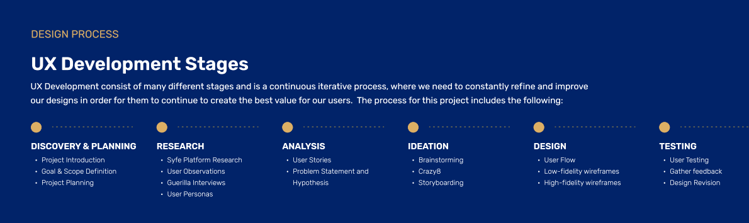

Slide 3
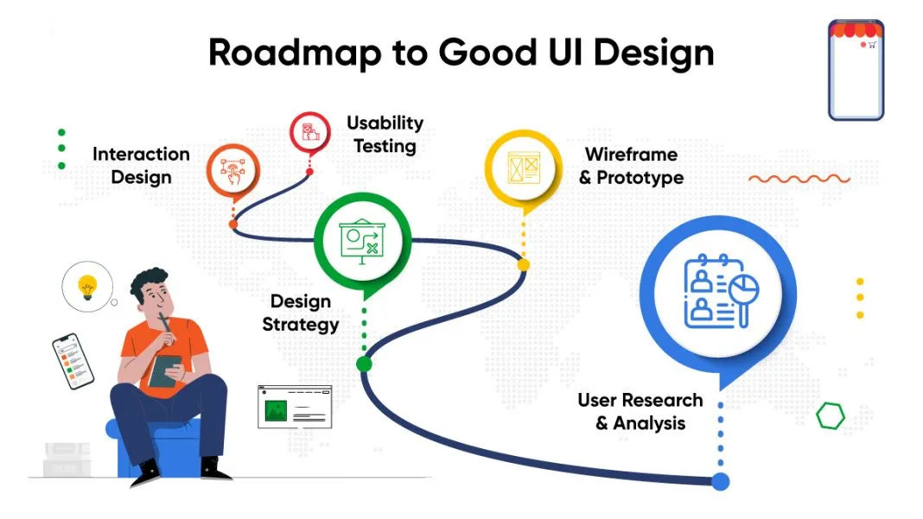

Slide 4
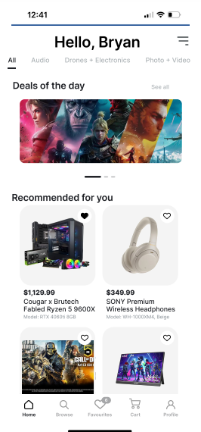
Project overview
The product:
An online store of accessories for gamers offering affordable prices. The target audience includes gamers aged 18 to 35 who are actively involved in the gaming community and are looking for a convenient, easy-to-use platform to purchase gaming products. The goal is to make shopping fun, fast and easy for all types of users.
Project duration:
January 2025 to March 2025

Slide 5
Project overview
The problem:
Available online shopping websites have cluttered designs, inefficient systems for browsing through products, and confusing checkout processes.
The goal:
Design a gaming accessories website that is user-friendly, provides clear navigation, and offers a quick checkout process.

Slide 6
Project overview
My role:
UX designer leading the development of a gaming accessories website, in conducting user experience research and developing a solution for our client. The solution will attract customers who buy gaming equipment and improve their shopping experience.
Responsibilities:
Conducting interviews, paper and digital wireframing, low and high-fidelity prototyping, conducting usability studies, accounting for accessibility, iterating on designs and responsive design..

Slide 7
User research
Personas
Problem statements
User journey maps
Understanding
the user

Slide 8


Slide 9
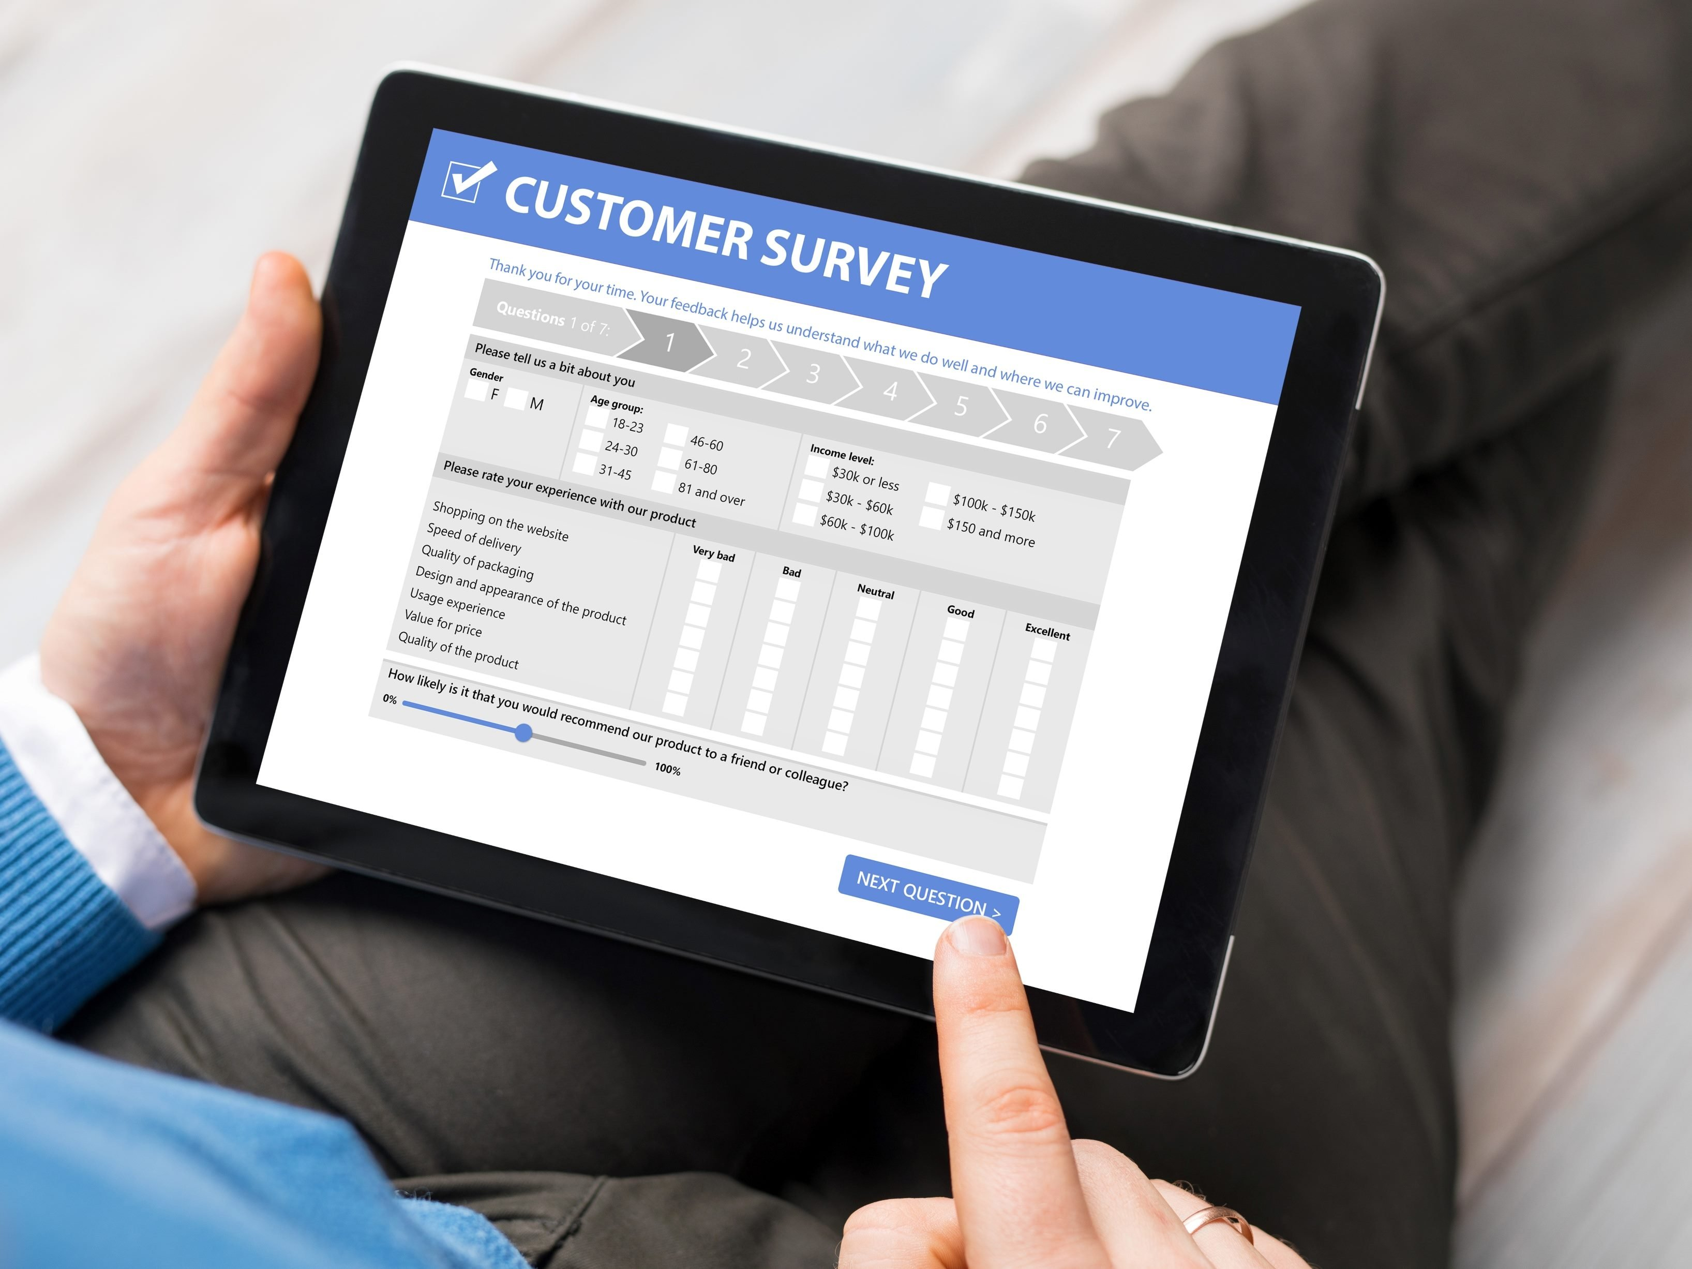
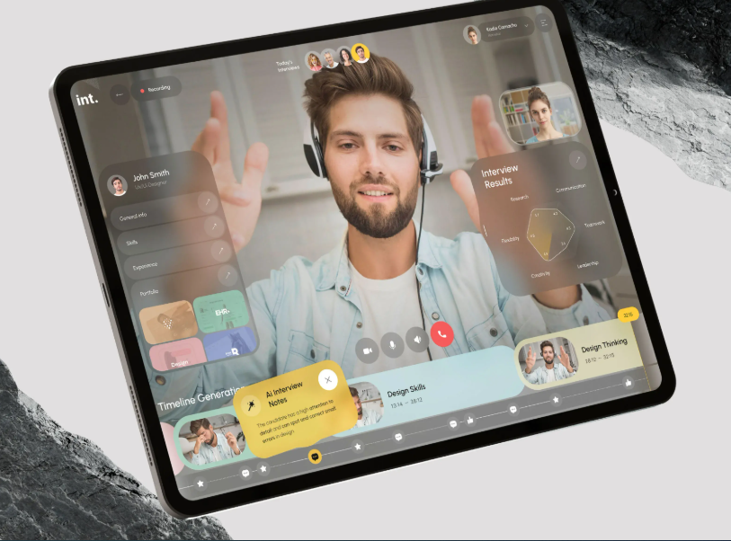
User Research
In my user research, I focused on gamers who purchase gaming equipment from online stores.
Screener & Interviews
12 surveys
15 interviews

Slide 10
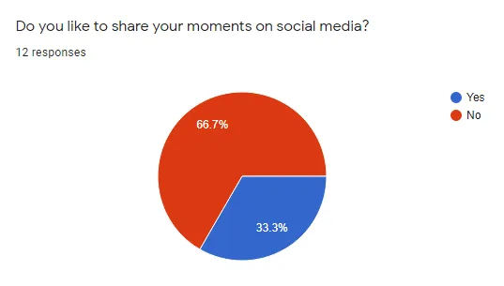
Before selecting the users I wanted to survey and interview for the study, I started with screening to ensure I was targeting the right users to interview.
The screening resulted in 44 responses, and 27 users were selected for the next stage.
Surveys and interviews allowed me to gain a deeper understanding of the challenges customers face when purchasing gaming equipment online. They gave us a glimpse into users' favorite gaming equipment, what they like and dislike. I also learned what other websites they use for their online purchases, which will be used for our business analysis later.

Slide 11
User research: summary
I conducted user interviews which I then turned into empathy maps to better understand the target user and their needs. I found that many target users view online shopping as a fun and relaxing activity when they need a break from school or work. However, many shopping sites are cluttered and confusing to navigate, which frustrated many target users. This resulted in what was usually a pleasant experience becoming difficult for them, defeating the purpose of relaxation..

Slide 12
User research: pain points
1
2
3
Pain point
Pain point
Pain point
Shopping website designs are often busy, which results in confusing navigation.
Small buttons on shopping websites make item selection difficult, which sometimes leads users to make mistakes
Online shopping sites do not provide an engaging browsing experience - they take a long time to load, affect performance and are overloaded with images.

Slide 13
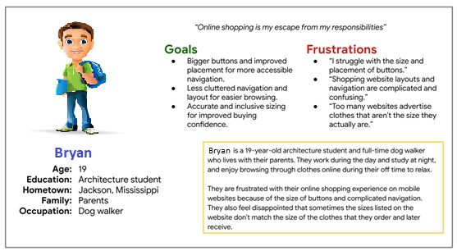
Persona: Bryan
Problem statement:
Bryan is a busy college student who needs intuitive website navigation and search filters because they want online shopping to be stress-free.

Slide 14
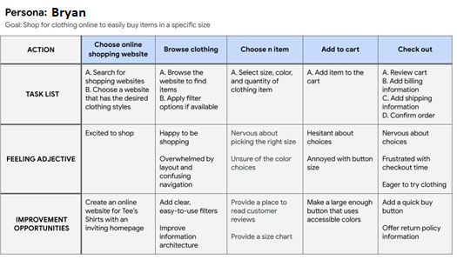
User journey map
I created a user journey map of Bryan’s experience using the site to help identify possible pain points and improvement opportunities.

Slide 15
Sitemap
Paper wireframes
Digital wireframes
Low-fidelity prototype
Usability studies
Starting
the design

Slide 16
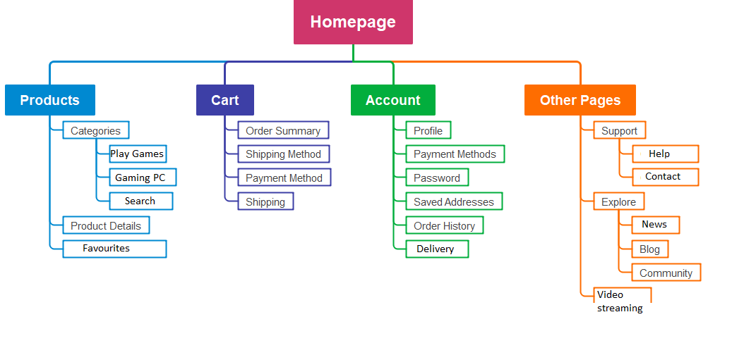
Sitemap
Difficulty with website navigation was a primary pain point for users, so I used that knowledge to create a sitemap.
My goal here was to make strategic information architecture decisions that would improve overall website navigation. The

Slide 17
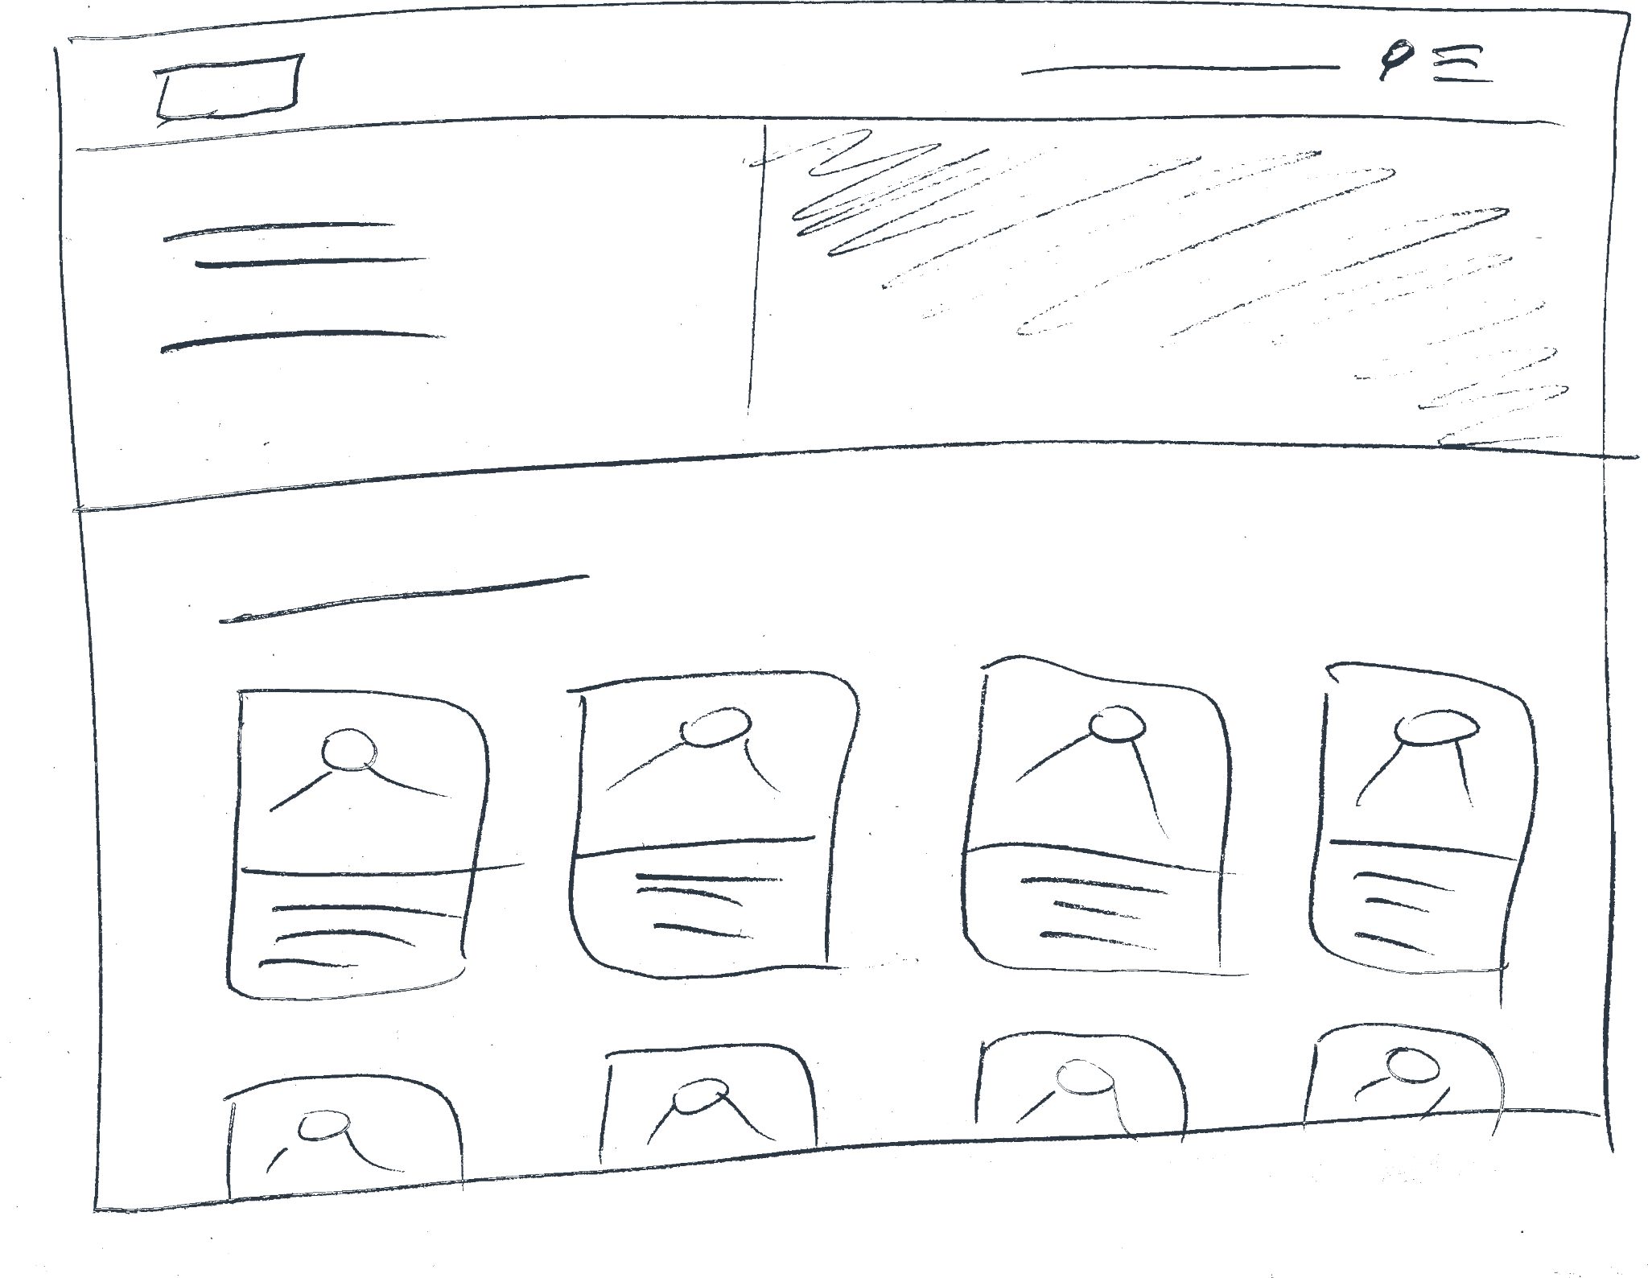
Paper wireframes
Focusing on the core features identified during user research, I sketched the first wireframes using pen and paper.

Slide 18
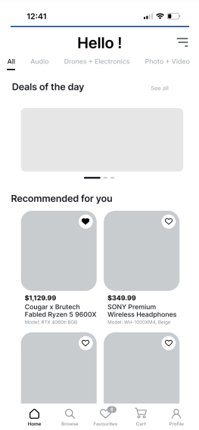
Homepage is optimized for easy browsing through the carousel of images and nav menu options
Digital wireframes
[The transition from paper to digital wireframes made it easier to understand how a redesign could help solve user pain points and improve the user experience.
Prioritizing useful buttons and placing visuals on the homepage was a key part of my strategy
Easy access to store products

Slide 19
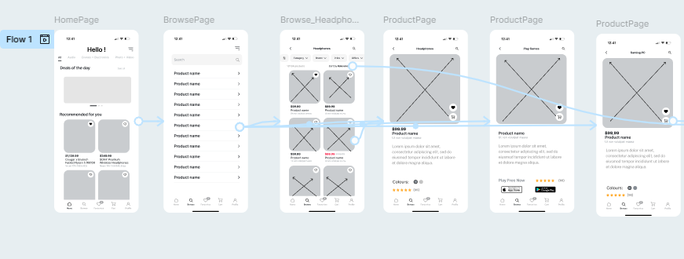
Low-fidelity prototype
I created a low-fidelity prototype from the user flow diagram and wireframes to test functionality before incorporating it into the final design and to ensure accessibility for end-users.
View Prototype:
Desktop
Mobile

Slide 20
Usability study: findings
These were the main findings uncovered by the usability study:
1
2
3
Cart
Checkout
Account
Once at the checkout screen, users didn’t have a way to edit the quantity of items in the cart
Users weren’t able to easily copy the shipping address information into the billing info field
During the checkout process, there wasn’t a clear way for users to log in to their account to pre-fill previous billing and shipping info

Slide 21
Usability study: parameters
Study type:
Unmoderated usability study
Location:
United States, remote
Participants:
5 participants
Length:
20-30 minutes

Slide 22
Refining
the design
Mockups
High-fidelity prototype
Accessibility

Slide 23
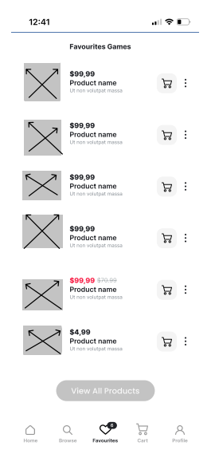
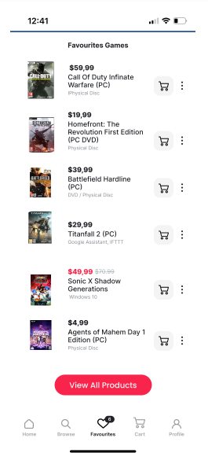
Mockups
Before usability study
After usability study
Based on the usability research results, I have applied design changes. These include adding more product information, adding color to the secondary navigation bar

Slide 24
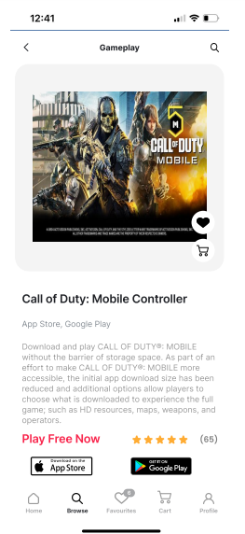
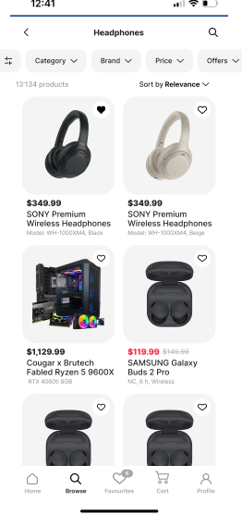
Mockups

Slide 25
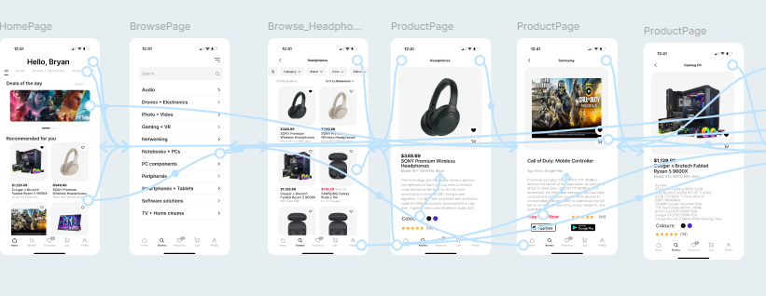
High-fidelity prototype
My hi-fi prototype followed the same user flow as the lo-fi prototype, and included the design changes made after the usability study, as well as several changes suggested by members of my team.

Slide 26
Accessibility considerations
1
2
3
I used headings with different sized text for clear visual hierarchy
I used landmarks to help users navigate the site, including users who rely on assistive technologies
I designed the site with alt text available on each page for smooth screen reader access

Slide 27
Going forward
Takeaways
Next steps

Slide 28
Takeaways
Impact:
Our target users shared that the design was intuitive to navigate through, more engaging with the images, and demonstrated a clear visual hierarchy.
What I learned:
I learned that even a small design change can have a huge impact on the user experience. The most important takeaway for me is to always focus on the real needs of the user when coming up with design ideas and solutions.

Slide 29
Next steps
1
2
Conduct follow-up usability testing on the new website
.
Identify any additional areas of need and ideate on new features
.

Slide 30
Insert a few sentences summarizing the next steps you would take with this project and why. Feel free to organize next steps in a bullet point list.
Let’s connect!
Thank you for your feedback on my work on the app
If you want to see more or want to contact me, my contact details are below:
Website: https://mscbuild.github.io/about/home.html

Slide 31
Thank you!

